Slide 1
Ceis 114 course project
Multiple traffic light controller with cross walk and an emergency buzzer with a smart sensor

Slide 2
Introduction
Building and programming of a two-way traffic light controller with a pedestrian crossing and an emergency signal
Building of the traffic lights by a design that has one set of traffic lights that is continuously active in one direction of a major street and always red traffic light on the minor street which has less traffic flow
Building the traffic lights by integrating IoT control to the traffic light project using cloud service. The controller would give emergency personal access to the traffic light control. Upon triggering IoT signal, all traffic from all directions will see red light and a flashing blue light.

Slide 3
Project Plan

Slide 4
Project inventory
ESP 32 Board
Colored LEDs: Red, Yellow, Green, and Blue
220 Ohm Resistors (optional)
Wires
Breadboard(s)
LCD Unit with I2C Adapter
Active Buzzer
Mini Router
Push Button(s)
PIR Motion Sensor

Slide 5
Installation of Arduino IDE

Slide 6
ESP32 (Picture)
Microcontroller mounted and powered ON

Slide 7
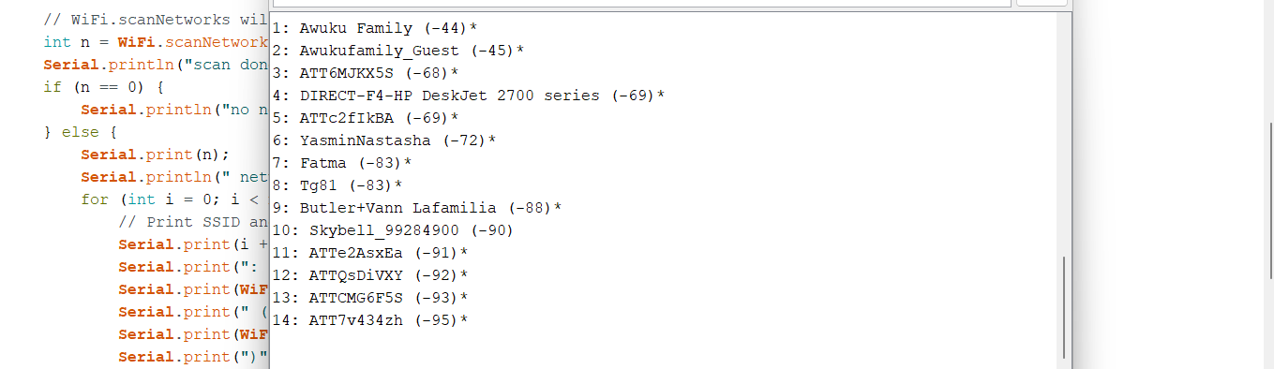
ESP32 Wi-Fi Scan

Slide 8
Creating the Traffic Controller

Slide 9
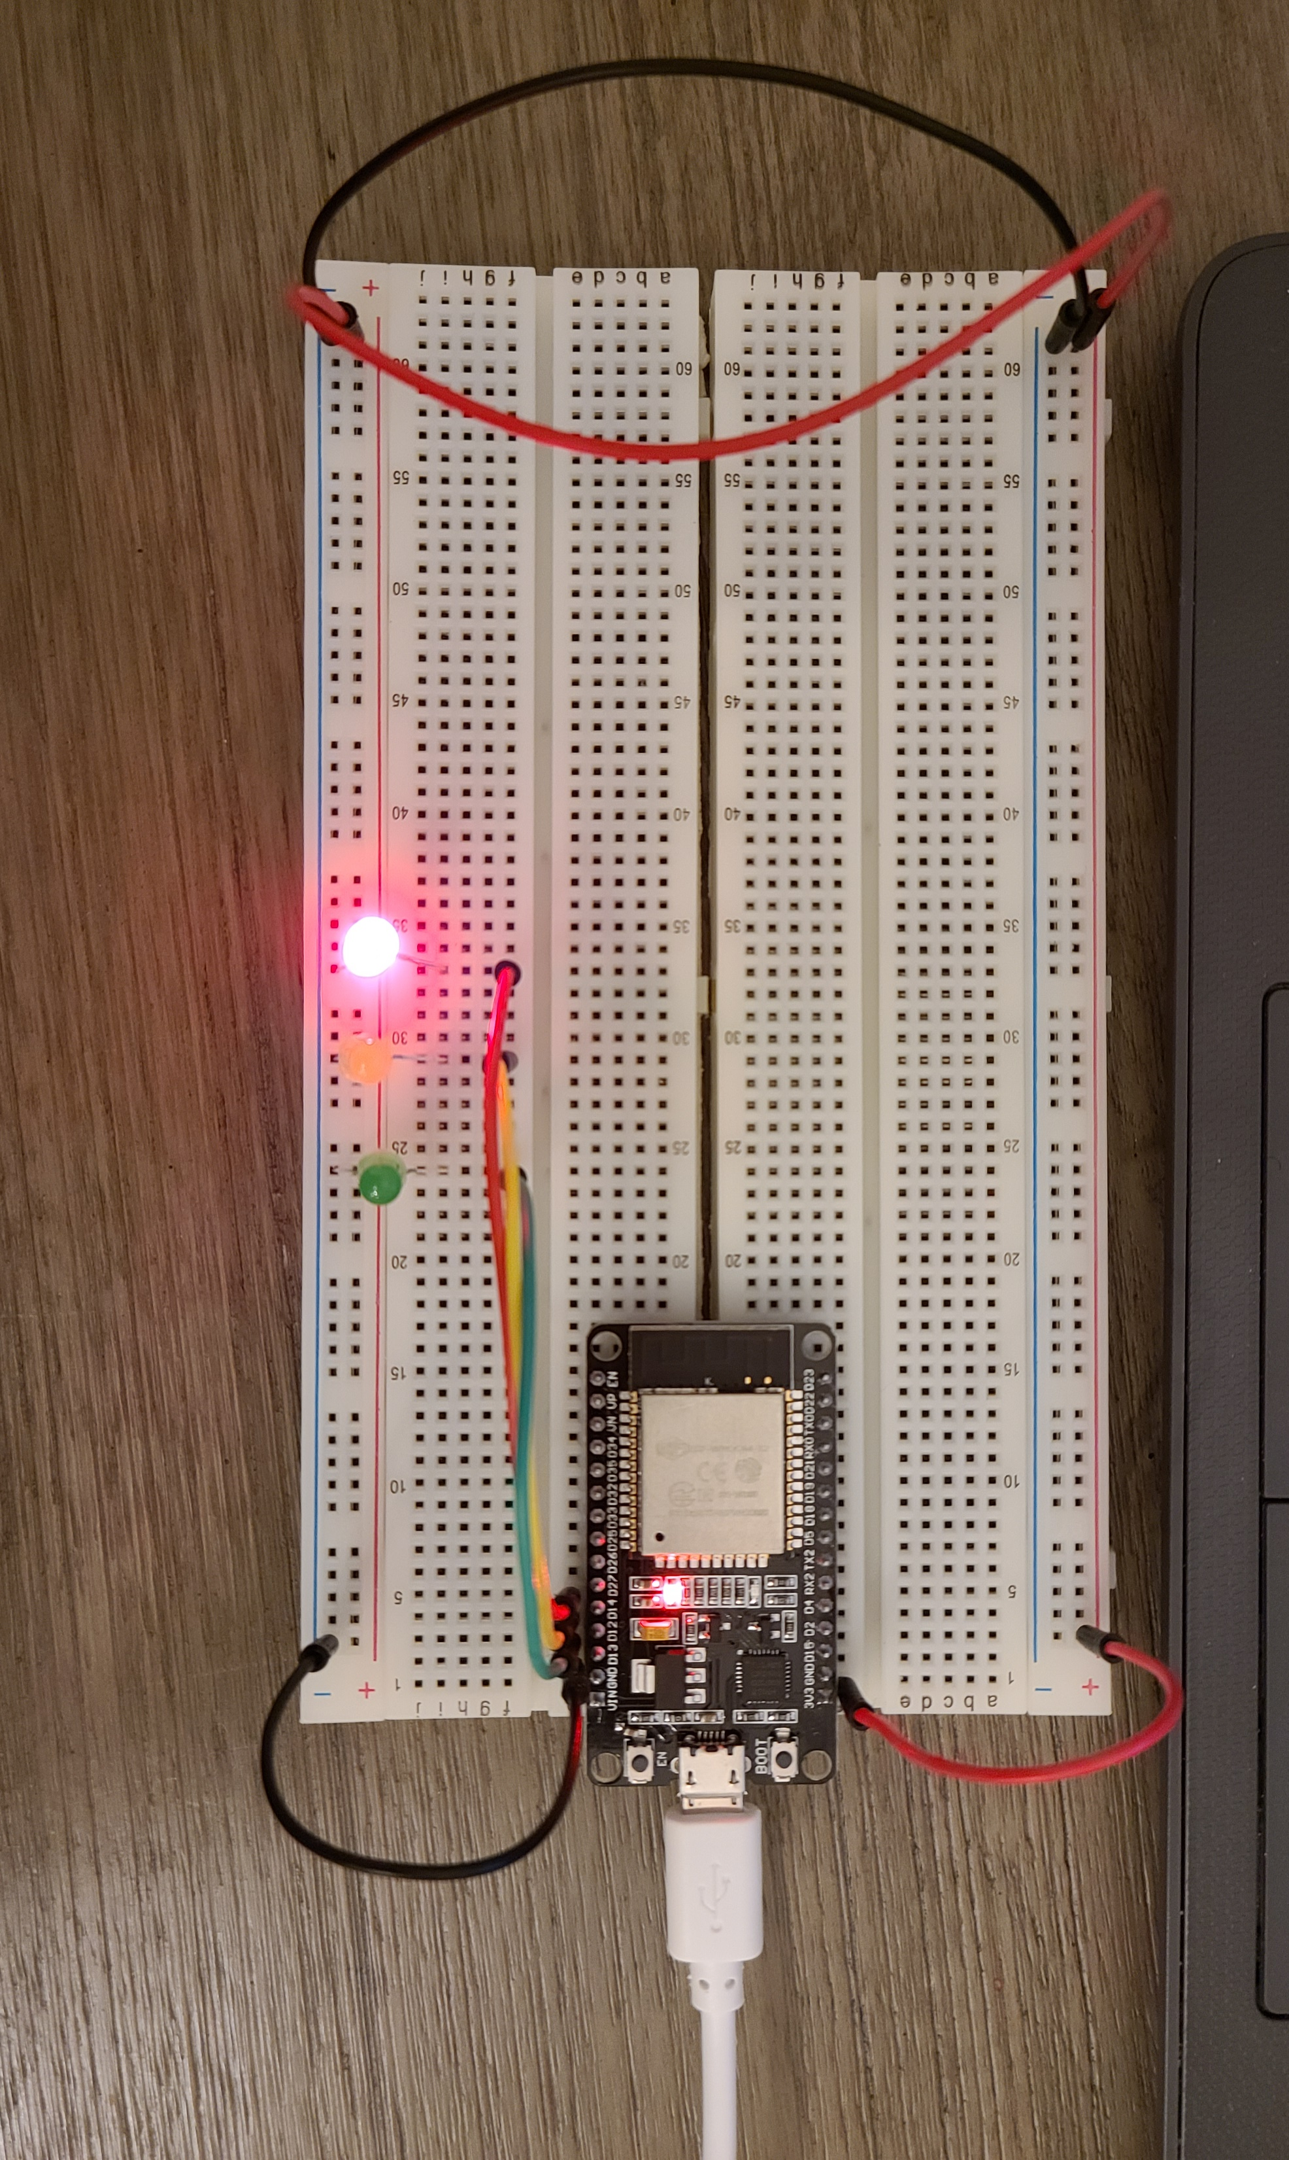
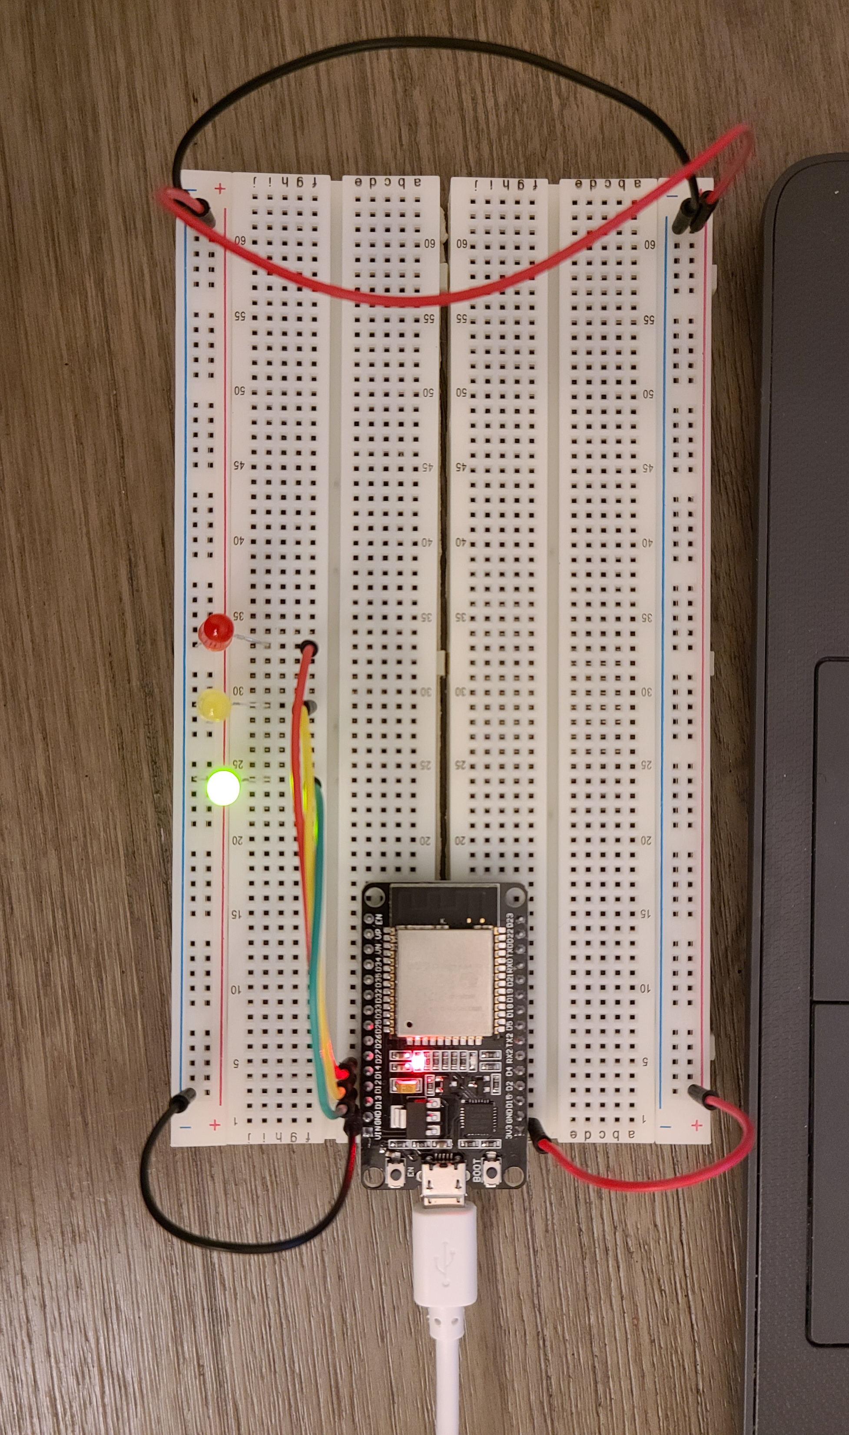
ADDING FIRST SET OF LED’s
Picture of circuit with working LEDs
ESP 32 Board
Colored LEDs: Red, Yellow and Green
220 Ohm Resistors (optional)
Wires
Breadboard

Slide 10
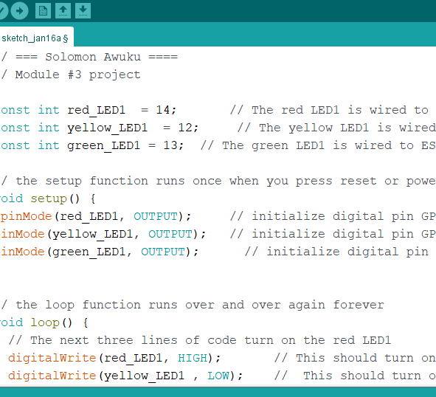
code in Arduino IDE

Slide 11
Creating a Multiple Traffic Light Controller

Slide 12
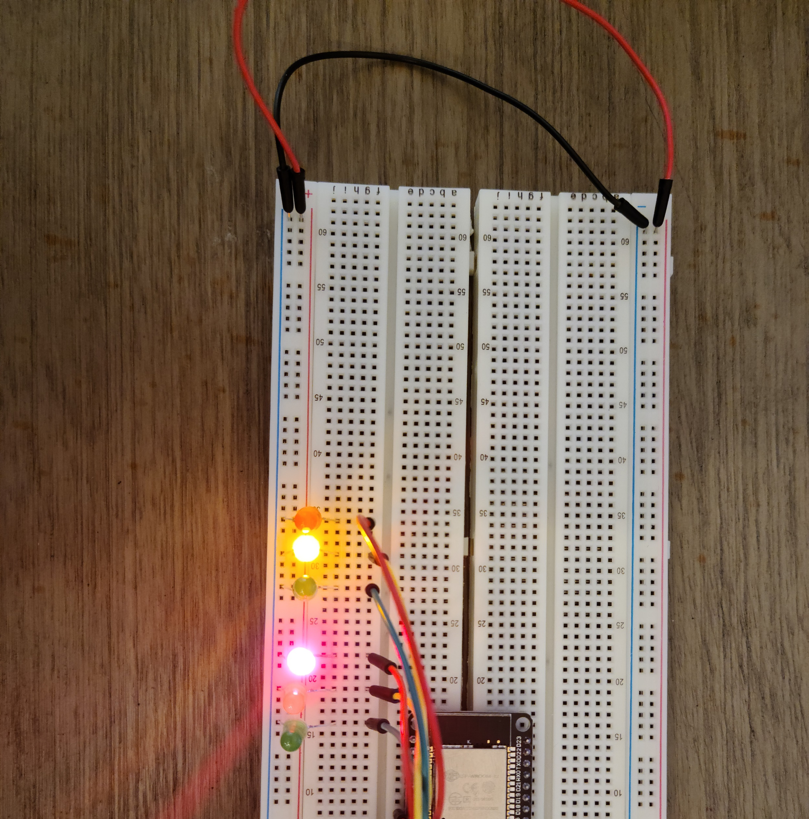
Picture of circuit with working LEDs
ESP 32 Board
Colored LEDs: Red, Yellow and Green (two sets)
220 Ohm Resistors (optional)
Wires
Breadboard

Slide 13
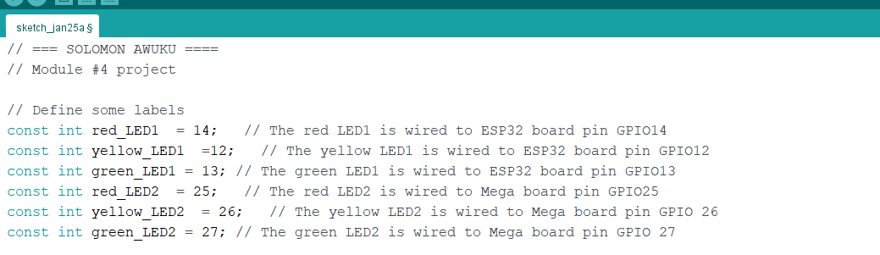
code in Arduino IDE

Slide 14
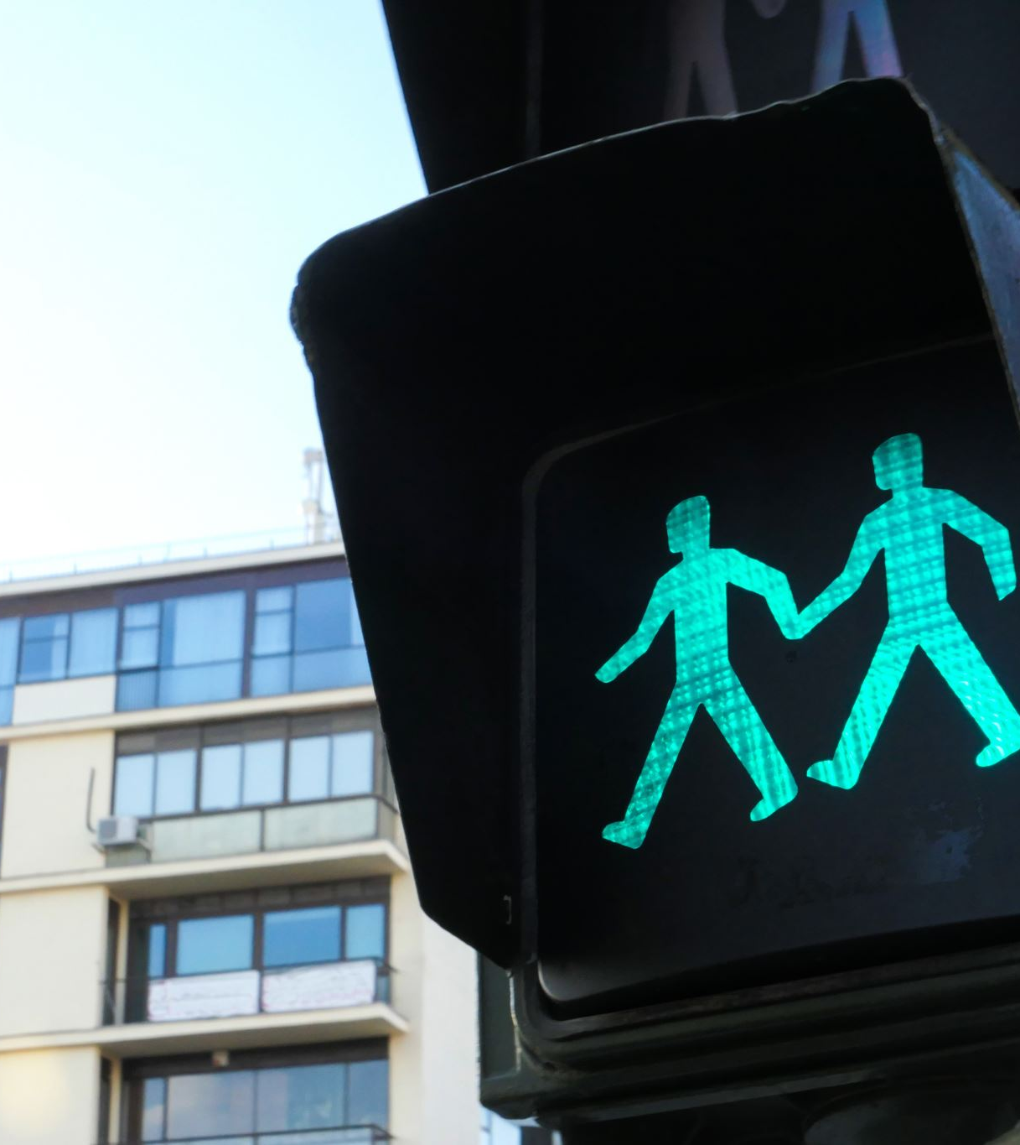
Creating a Multiple Traffic Light Controller with a Cross Walk

Slide 15
Picture of circuit with working LEDs
ESP 32 Board
Colored LEDs: Red, Yellow and Green (two sets)
220 Ohm Resistors (optional)
Push Button
Wires
Breadboard

Slide 16
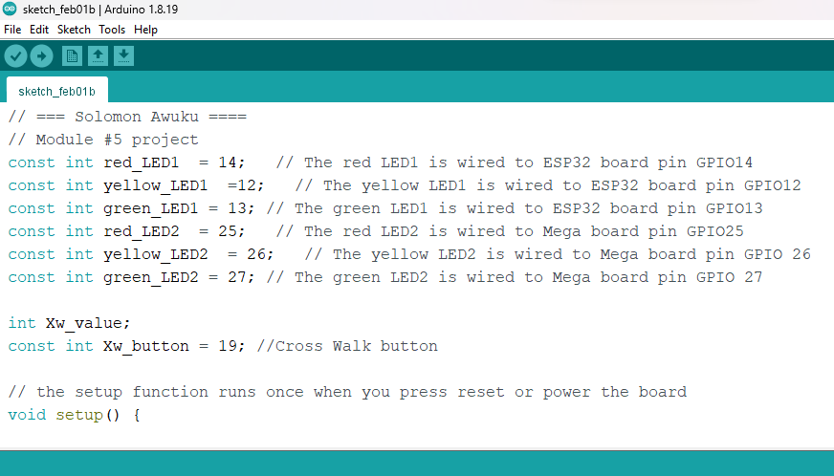
code in Arduino IDE

Slide 17
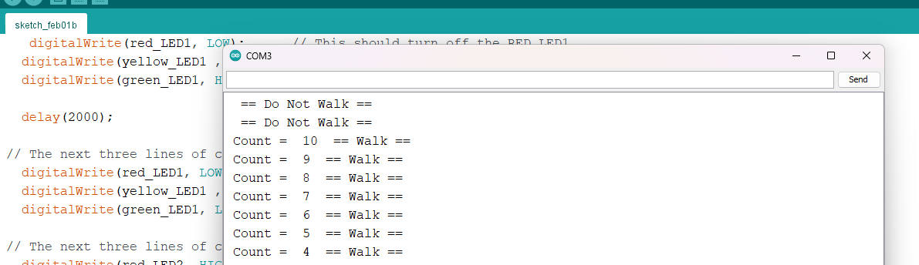
Serial Monitor in Arduino IDE

Slide 18
Creating a Multiple Traffic Light Controller with a Cross Walk and an Emergency Buzzer

Slide 19
Picture of circuit with working LEDs and LCD display
ESP 32 Board
Colored LEDs: Red, Yellow and Green (two sets)
220 Ohm Resistors (optional)
Push Button
LCD Unit with Message Display
Wires
Breadboard

Slide 20
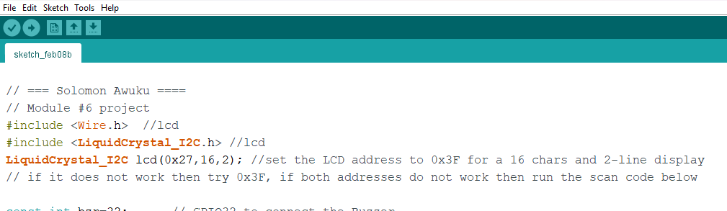
code in Arduino IDE

Slide 21
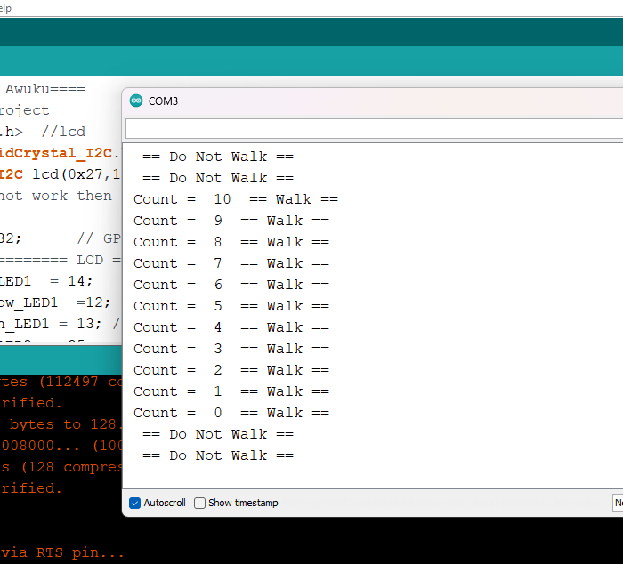
Serial Monitor in Arduino IDE

Slide 22
Creating a Multiple Traffic Light Controller with a Cross Walk and an Emergency Buzzer with secured IoT Control via Web

Slide 23
Picture of circuit with working LEDs and LCD display
ESP 32 Board
Colored LEDs: Red, Yellow and Green (two sets)
One Blue LED – Emergency Light
220 Ohm Resistors (optional)
Push Button
LCD Unit
Buzzer
Wires
Breadboard

Slide 24
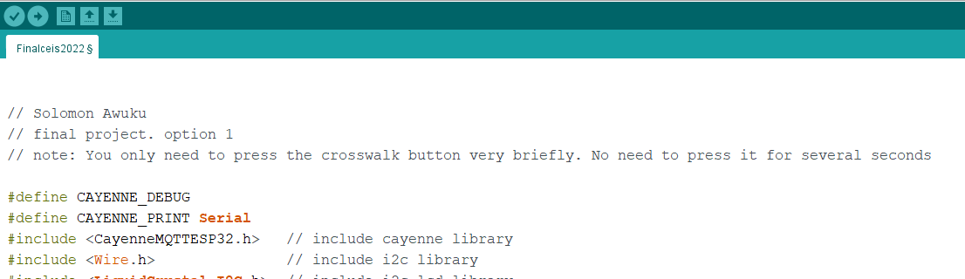
code in Arduino IDE

Slide 25
Serial Monitor in Arduino IDE
output in Serial Monitor

Slide 26
CHARLLENGE
Issue with LCD screen due to low contrast . Screen couldn’t be read .
Determining the correct pin placement of the ESP 32
Changing out buttons and LEDs due to blown out
Manipulating two breadboards for ESP32 DEV KIT VI

Slide 27
CAREER SKILLS
Security awareness
Automation
Programming and coding
Networking and connectivity abilities
Understanding of IOT
Operating system fundamentals

Slide 28
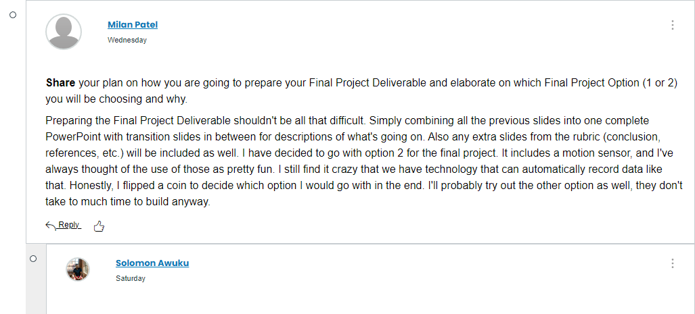
MODULE 7 DISCUSSION SCREENSHOT

Slide 29
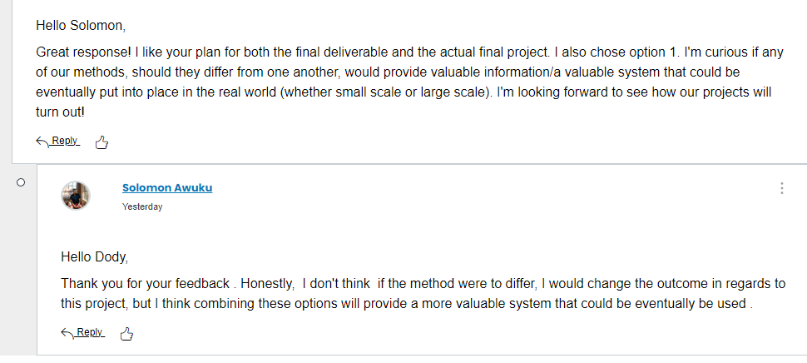
MODULE 7 DISCUSSION SCREENSHOT continuous

Slide 30
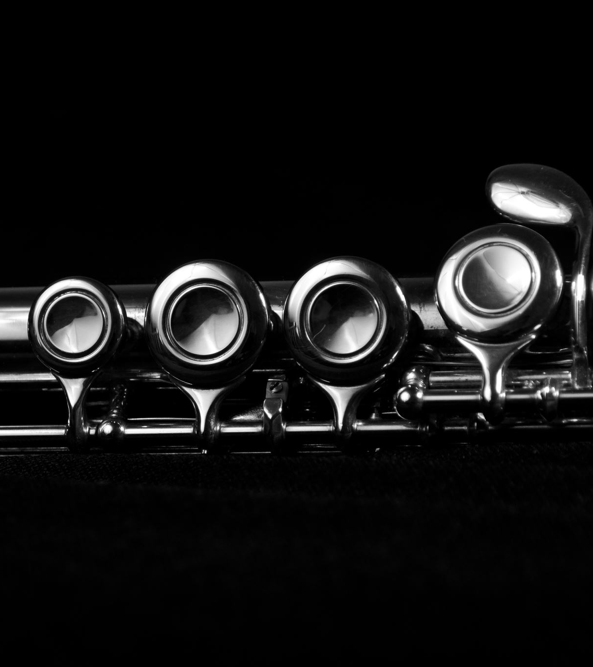
CONCLUSIONS
With the current growth in connected devices, each device in the IOT system communicates pockets of data that requires reliable connectivity, storage and security
These projects will help us deal with such challenges as monitoring, managing and securing large volumes of data

